Slide 1


K.RAMAKRISHNAN COLLEGE OF ENGINEERING
(AUTONOMOUS)
AI DESKTOP PARTNER
Presented by,
Name RANJANI R
Register No. : 8115U23AD045
Roll. No. : AD2345
Year : II

Slide 2
PRESENTATION OVERVIEW
Introduction
Problem identification
Objectives
Literature review
Architecture diagram
Working Principle
Modules identification
Coding
Future Scope
Reference

Slide 3
INTRODUCTION
AI desktop partner, that were developed upon computing technologies, seem to be nice helpers with many choices that make life easier for users . A straight forward access to the machine through voice commands is that the revolutionary way of approaching human-system interaction. To finish tasks more efficiently via voice interaction, speech to text API is used for understanding the input. Further considerably, these assistants’ answers users query via voice commands by Natural Language Processing (NLP) which will be thought of like real conversations with an individual.

Slide 4
PROBLEM IDENTIFICATION
User Productivity Needs: Identify the need for a tool that enhances productivity by managing tasks, reminders, and providing quick access to information.
Natural Interaction: Recognize the demand for a desktop assistant that can interact with users in a natural, conversational manner, reducing the need for complex commands.
Information Overload: Address the issue of users being overwhelmed by information, requiring an AI assistant that can filter, organize, and present relevant data efficiently.

Slide 5

Task Management: Identify the problem of managing multiple tasks simultaneously, requiring an AI partner that can help users prioritize and track their activities.
Personalization: Recognize the challenge of creating a personalized experience that adapts to individual user preferences and behaviors.
Ease of Access: Identify the need for quick and easy access to tools and information without disrupting the user's workflow.

Slide 6
OBJECTIVES
The objective of an AI desktop partner is to assist users in managing their daily tasks,
improving productivity, and enhancing the overall user experience on a computer. It aims
to provide personalized support by automating routine activities, offering intelligent
suggestions, and quickly accessing information, all while being easily accessible from your
desktop. The goal is to make your work more efficient, reduce the time spent on repetitive
tasks, and help you stay organized and focused.

Slide 7

S.NO | YEAR | TITLE | AUTHORS | ALGORITHM | DISADVANTAGE
1 | 2022 | AI qualification during dual vocational training | Karin Julia Rott , Lena Lao | k-Fold Cross-Validation. | Decision-making, leading to reduced critical thinking and problem-solving skills

Slide 8
LITERATURE REVIEW
S.NO | YEAR | TITLE | AUTHORS | ALGORITHM | DISADVANTAGE
2 | 2023 | varoka_-chatbot | S.Navaneethan P.Roshini | Support Vector Machines (SVM), BERT (Bidirectional Encoder Representations from Transformers) | Limited Understanding and Maintenance and Updates

Slide 9
S.NO | YEAR | TITLE | AUTHORS | ALGORITHM | DISADVANTAGE
3 | 2023 | Public value creation of AI within public administration | Luca Tangi | Q-Learning, Deep Q-Networks (DQN). | Updating algorithms, and fixing bugs.

Slide 10

S.NO | YEAR | TITLE | AUTHORS | ALGORITHM | DISADVANTAGE
4 | 2024 | Human-AI interaction research agenda: A user-centered perspective | Tingting Jiang , Zhumo Sun | Conditional Random Fields (CRF), Bidirectional LSTM with CRF | Hacking attempts or breaches.

Slide 11
S.NO | YEAR | TITLE | AUTHORS | ALGORITHM | DISADVANTAGE
5 | 2024 | AI-mediated informal digital learning of English (AI-IDLE) | Ron Darvin | Word2Vec, or Sentence Transformers | The absence of empathy.

Slide 12
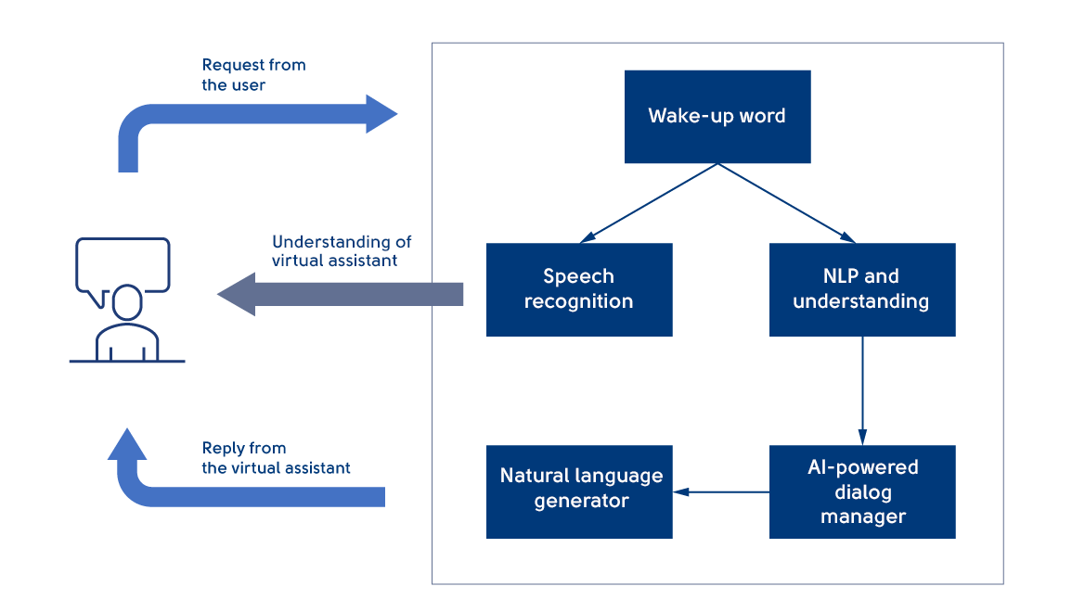
ARCHITECTURAL DIAGRAM
.

Slide 13
WORKING PRINCIPLE
User Input and NLP Processing:
The AI desktop partner starts by receiving user input, which can be text or voice commands.
Natural Language Processing (NLP) techniques like tokenization, part-of-speech tagging, and named entity recognition (NER) are applied to understand the user's intent and extract relevant information.

Slide 14
WORKING PRINCIPLE
Intent Recognition and Response Generation:
The system uses intent classification algorithms to determine what the user wants to achieve (e.g., setting a reminder, searching for information).
Based on the recognized intent, the AI either retrieves information from a knowledge base, interacts with external APIs, or performs a specific action on the user's desktop.

Slide 15
WORKING PRINCIPLE
Dialogue Management:
The AI manages the flow of conversation using dialogue management systems, which can involve finite state machines (FSM) or more advanced techniques like reinforcement learning.
The system keeps track of the context and maintains continuity in conversation, ensuring relevant responses throughout the interaction.

Slide 16

Natural Language Generation (NLG):
Once the AI has determined the appropriate response or action, it uses NLG techniques to generate a human-like response.
The response is tailored to be coherent and contextually appropriate, aiming to provide a seamless and natural user experience.

Slide 17

System Integration and Resource Management:
The AI desktop partner integrates with other applications and system resources on the user's device, allowing it to perform a wide range of tasks, from file management to scheduling events.
Efficient resource management ensures that the AI operates smoothly without significantly impacting the system’s performance.

Slide 18
MODULE DESCRIPTION
1.Natural Language Understanding (NLU) Module
Purpose: To process and understand user inputs by breaking them down into manageable components.
2.Dialogue Management Module
Purpose: To manage the flow of conversation, ensuring it remains coherent and contextually appropriate.
3.Analytics and Monitoring Module
Purpose: To collect data on interactions, measure performance, and provide insights for continuous improvement.

Slide 19

4.Response Generation Module
Purpose: To generate a natural and contextually appropriate response to the user.
5.Backend Integration Module
Purpose: To connect the chatbot with external systems and databases.
6.User Interface (UI) Module
Purpose: To provide an interactive and user-friendly interface for engaging with the
chatbot.

Slide 20
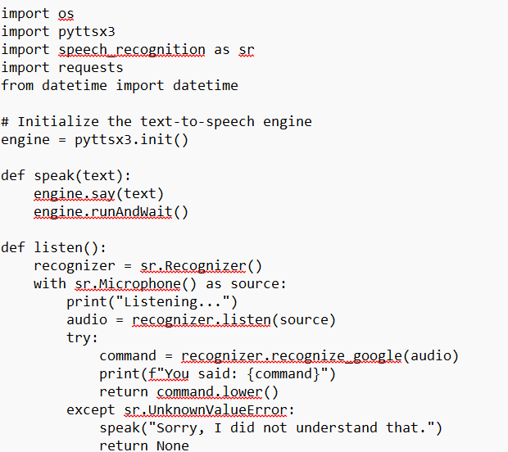
CODING

Slide 21
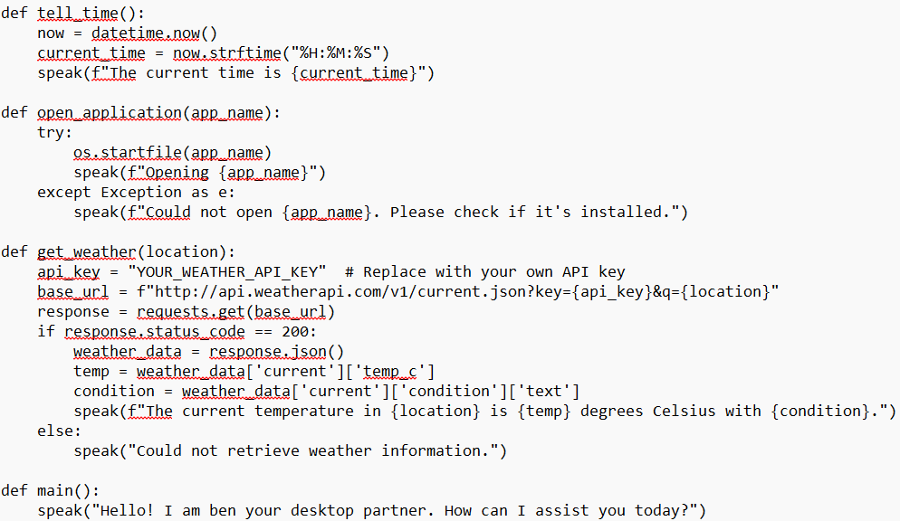
CODING

Slide 22
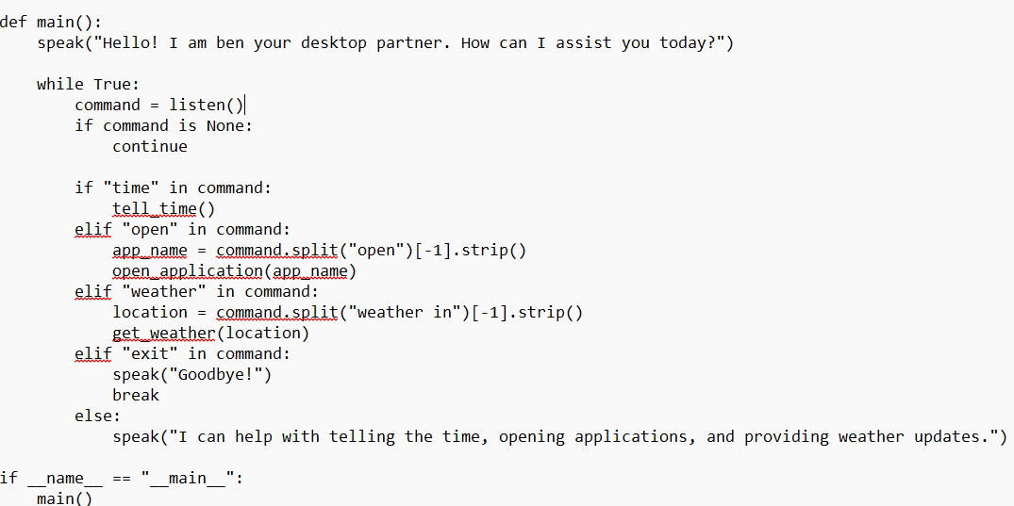
CODING

Slide 23
OUTPUT
Listening..
Assistant: I am ben your AI desktop partner
Listening..
You: Tell me a time
Assistant: The current time is ten hours twenty five minutes 30 seconds
Listening..
You: Can you open the notepad
Assistant: Yes notepad is here
Listening..
Assistant: I can help with telling the time, opening applications, and providing weather updates.
Listening….
You: exit
Assistant: Goodbye! Have a great day!

Slide 24
CONCLUSION
The development of the AI Desktop Partner highlights the transformative potential of artificial intelligence in enhancing productivity and user interaction within desktop environments. By integrating natural language processing, machine learning, and secure interaction frameworks, the AI Desktop Partner provides users with a powerful tool for task automation, intelligent assistance, and personalized experiences. AI Desktop Partner is a significant step forward, its full potential lies in ongoing refinement and adaptation to evolving user needs and technological advancements. This underscores the importance of continuous research and development to ensure its relevance and utility in an increasingly AI-driven world.

Slide 25
FUTURE SCOPE
Behavioral Understanding: AI can better understand user preferences and habits, offering more relevant recommendations.
Contextual Assistance: Adapt to the user's mood, work context, and environment for seamless support.
Multilingual Support: Enable more robust interactions in multiple languages.
Emotion Detection: AI can analyze voice tone or text input to understand emotional context.
Conversational AI: Evolve into more human-like, engaging dialogues.

Slide 26
REFERENCE
AI qualification during dual vocational training- Karin Julia Rott , Lena Lao
Public value creation of AI within public administration -Tingting Jiang , Zhumo Sun
Human-AI interaction research agenda: A user-centered perspective-Luca Tangi

Slide 27


